Slide 1
Monday, September 24
Happy Monday!
Let's go over the answers to the Real v. Nominal Activity from Friday.
Your second set of Outside Work for Unit II is due tomorrow!
Problem Set is due Thursday – this includes the Unit II Study Guide... pace yourself this week.... you need do a little something each night.
FRQ is next Tuesday; MC is next Wednesday

Slide 2
1. Define Macroeconomics.
2. What are 3 economic goals of every country?
3. What are the 3 key elements of the definition of GDP?
4. How do we use GDP?
5. What is not included in GDP?
6. What are the four components of GDP?
7. Define inflation.
8. Explain the difference between real and nominal GDP.
9. What is Real GDP per capita?
10. Name 10 Disney Princesses.

Slide 3
Unit 2:
Macro Measures
Copyright
ACDC Leadership 2015
3

Slide 5
The Business Cycle
The national economy goes up and down like a rollercoaster. A recession is a 6 month period of decline of Real GDP. Depression is really bad...
Real GDP
Inflation
Unemployment
Peak
Real GDP
Trough
Full Employment
Recession (Contraction)
Recovery (Expansion)
Time
Copyright
ACDC Leadership 2015

Slide 6
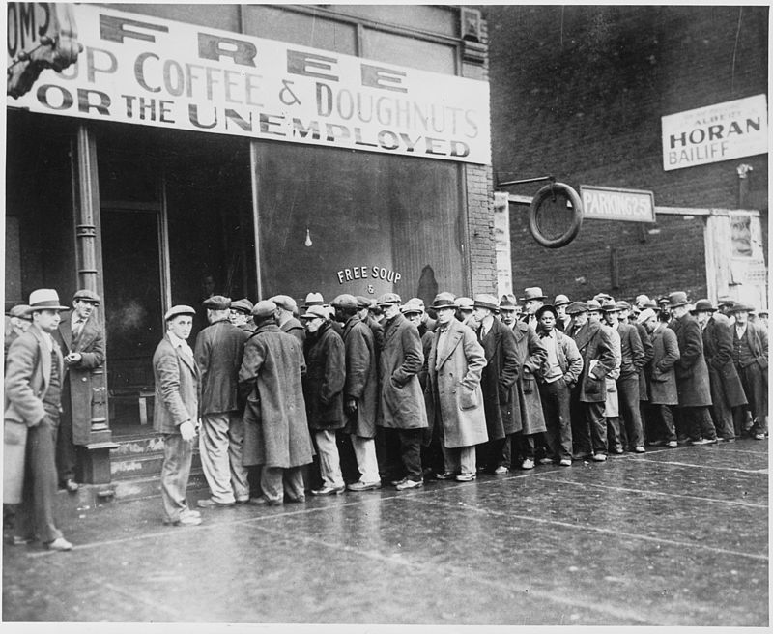
Goal #2
Limit Unemployment
Copyright
ACDC Leadership 2015
6

Slide 7
What is Unemployment?
Unemployment- Workers that are actively looking for a job but aren’t working
The Unemployment Rate- The percent of people in the labor force who want a job but are not working.
Unemployment
rate
# unemployed
x
=
100
# in labor force
Who is in the Labor Force?
Above 16 years old
Able and willing to work
Not institutionalized (in jails or hospitals)
Not in military, in school full time, or retired
Why is a stay at home mom not unemployed?
Copyright
ACDC Leadership 2015
7

Slide 8
2008 Audit Exam
Notes:
C

Slide 9
Three Types of Unemployment
Copyright
ACDC Leadership 2015
9

Slide 10
3 Types of Unemployment
#1. Frictional Unemployment
Frictional unemployment- Temporary unemployment or being between jobs
Individuals are qualified workers with transferable skills.
Examples:
High school or college graduates looking for jobs.
Individuals that were fired and are looking for a better job.
Seasonal Unemployment is a specific type of frictional unemployment which is due to time of year and the nature of the job.
Copyright
ACDC Leadership 2015
10

Slide 11
3 Types of Unemployment
#2. Structural Unemployment
Structural Unemployment- Changes in the labor force make some skills obsolete.
These workers DO NOT have transferable skills and these jobs will never come back. Workers must learn new skills to get a job.
The permanent loss of these jobs is called “creative destruction”
Examples: VCR repairmen, Milkmen
Technological Unemployment- Type of structural unemployment where automation and machinery replace workers
Copyright
ACDC Leadership 2015
11

Slide 12
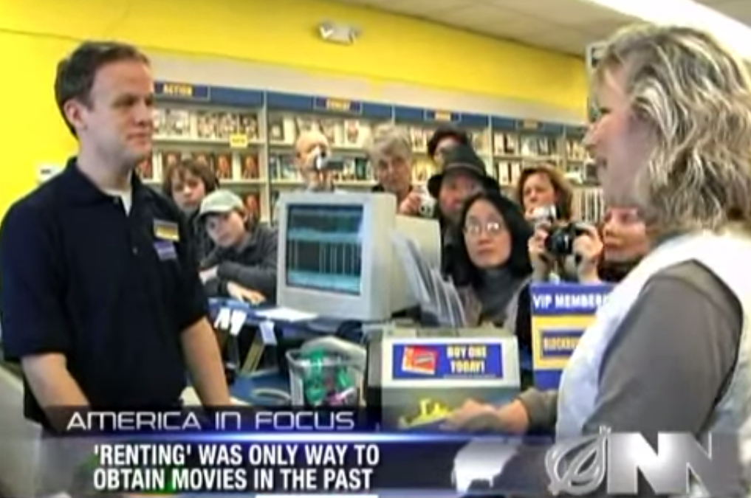
Some Jobs Disappear
Copyright
ACDC Leadership 2015

Slide 13
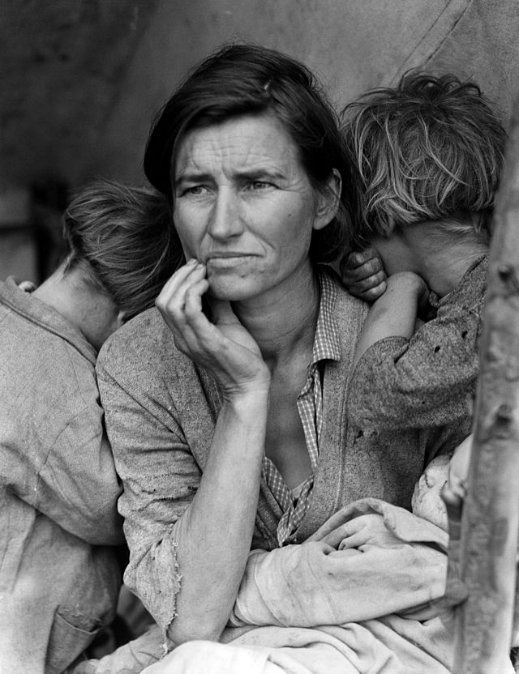
3 Types of Unemployment
#3 Cyclical Unemployment
Cyclical Unemployment- Unemployment caused from a recession
As demand for goods and services falls, demand for labor falls and workers are fired
This is sometimes called “demand deficient unemployment”
Examples:
Steel workers laid off during recessions
Restaurant owners fire waiters after
months of poor sales due to recession
High unemployment during the
Great Depression
Copyright
ACDC Leadership 2015
13

Slide 14
Natural Rate of Unemployment (NRU)
Many people assume that our goal is zero percent unemployment, but it’s not. Why?
Copyright
ACDC Leadership 2015

Slide 15
The Natural Rate of Unemployment
Frictional and structural unemployment are present at all times because people will always be between jobs or replaced by technology.
So, the economy is doing great if there is only frictional and structural unemployment.
Natural Rate of Unemployment (NRU)- Frictional plus structural unemployment. The amount of unemployment that exists when the economy is healthy and growing.
Full Employment Output (Y)- The Real GDP created when there is no cyclical unemployment
The US is at full employment when there is 4-6% unemployment
15

Slide 16
The PPC and the Business Cycle
Max Capacity
0% Unemployment
Real GDP
Capital Goods
Real
GDP
Consumer Goods
Time
6+% Unemployment
Full Employment
5% Unemployment
4-6% Unemployment
Super low unemployment leads to inflation
Copyright
ACDC Leadership 2015
16

Slide 17
The Natural Rate of Unemployment
The natural rate in France and Germany is around 8–10%. Why?
Some economists attribute the difference to more generous unemployment benefits in European countries
In the U.S. unemployment benefits last for 6 months
Unemployment benefits in some European countries are indefinite
The generous benefits reduce incentives to search for a job
Copyright
ACDC Leadership 2015
Notes:
17
Unemployment benefits in the U.S. are often extended to 9 months or 1 year during periods of high unemployment.

Slide 18
Econmovies
Episode 6: Back to the Future

Slide 19
Criticisms of the Unemployment Rate
The unemployment rate can misdiagnose the actual unemployment rate because of:
Discouraged Workers-
Some people are no longer looking for a job because they have given up.
Labor Force Participation Rate
Percent of population in the labor force.
If people leave labor force the unemployment rate falls
Underemployed Workers-
Someone who wants more hours but can’t get them is still considered employed.
Race/Age Inequalities-
The overall unemployment rate doesn’t show disparity for minorities and teenagers
Copyright
ACDC Leadership 2015
19

Slide 20
Are You Unemployed?

Slide 21
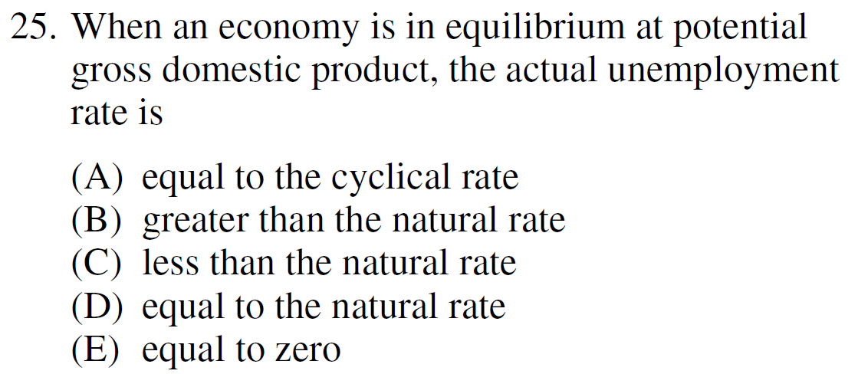
2013 Audit Exam
Notes:
D

Slide 22
2008 Audit Exam
Copyright
ACDC Leadership 2015
22
Notes:
C

Slide 23
2006 Practice FRQ
Copyright
ACDC Leadership 2015
23

Slide 24
The Business Cycle Quiz
Identify the parts of the business cycle 1-7
Real GDP
#5
#6
#1
Real GDP
#2
#7
#3
#4
Time
Copyright
ACDC Leadership 2015

